Slide 1



Career Guide & Getting Started With Microsoft .NET
By : SYED SHANU
Email: syedshanumcain@gmail.com
Date : 2017/08/29

Slide 2

About Me
My Name is Syed Shanu
From Madurai, Tamil Nadu, India
Microsoft MVP
Code Project MVP
Csharp Corner MVP
11+ years of Experience as Software Engineer
Working as a Senior Software Engineer at Seoul ,Korea

Slide 3
Agenda
.NET Framework History
Getting started with Microsoft .NET Console and Winform application.
Getting Started with SQL Server
Introduction to ADO.NET and Web Forms Application
Introduction to WEB API ,Entity Framework
Introduction to ASP.NET Core
How to improve your Career on Microsoft .NET Technology
Learn and Teach Microsoft .NET Technology

Slide 4
.NET Framework History
.Net Framework Version | Visual Studio IDE | Features
.Net Frame Work 1.0 | Visual Studio .Net | CLR 1.0 (Common Language Runtime)
.Net Frame Work 1.1 | Visual Studio 2003 | Mobile ASP.NET controls,Features added for ASP.NET and ADO.NET
.Net Frame Work 2.0 | Visual Studio 2005 | CLR 2.0,Partial Class,Nullable Types,Data tables
.Net Frame Work 3.0 | Expression Blend | WPF(Windows Presentation Foundation) , WCF (Windows Communication Foundation)
.Net Frame Work 3.5 | Visual Studio 2008 | LINQ (Language Integrated Query) ,ASP.NET AJAX,ASP.NET MVC 1.0,2.0
.Net Frame Work 4.0 | Visual Studio 2010 | CLR 4.0,ASP.NET MVC 2.0,3.0,Dynamic Language Runtime
.Net Frame Work 4.5 | Visual Studio 2012 | ASP.NET MVC 4.0,Asp.NET Web API, SignalR
.Net Frame Work 4.5.1 | Visual Studio 2013 | ASP.NET MVC 5.0
.Net Frame Work 4.6 | Visual Studio 2015 | ASP.NET 5 (ASP.NET Core) , ASP.NET MVC 6
.Net Frame Work 4.6.1 | Visual Studio 2015 Update 1 | ASP.NET Core
.Net Frame Work 4.7 | Visual Studio 2017 | ASP.NET Core 2.0

Slide 5
Session Prerequisites
Visual Studio 2015/2017
SQL Server 2014
Download Links
1.First download Visual Studio 2015 or Download Visual Studio 2017.
2. Microsoft SQL Server 2014 Express

Slide 6

Getting Started with Visual Studio
Console Application
Windows Forms Application Development
Web Application Development
Windows App development

Slide 7
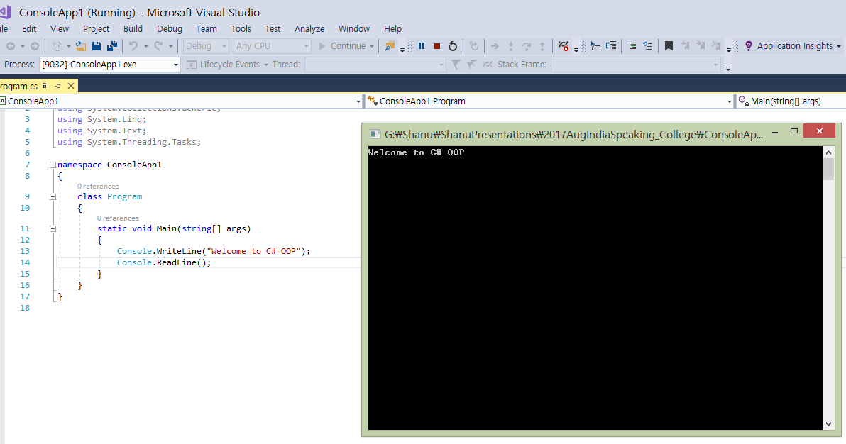
Working with Console Application

Slide 8
Introduction to C# OOP
Microsoft .NET supports multiple languages including VB.NET, C#, and F#. C# is the most popular among them and there are more jobs in C#.
Class
Object
Variable
Method
Access Modifiers
Encapsulation
Abstraction
Inheritance
Polymorphism
Abstract Class/Method
Virtual Method
Sealed Class/Method
Static Class/Method
Interface

Slide 9







Introduction to SQL SERVER
DBMS
Software
Database

Slide 10
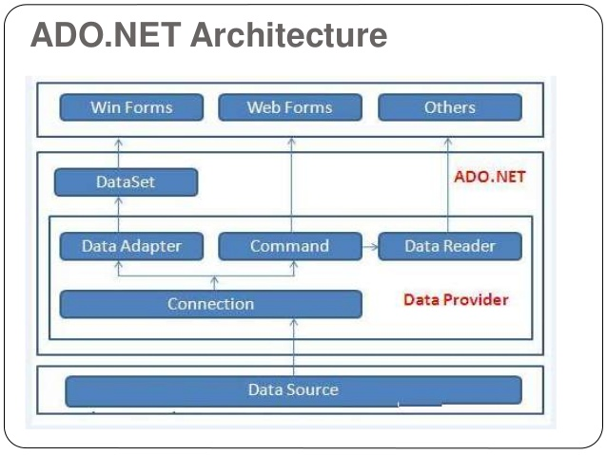
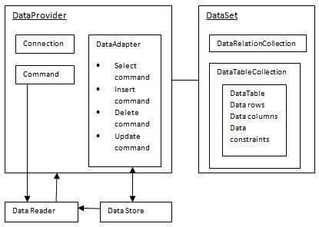
Introduction to ADO.NET

Slide 11
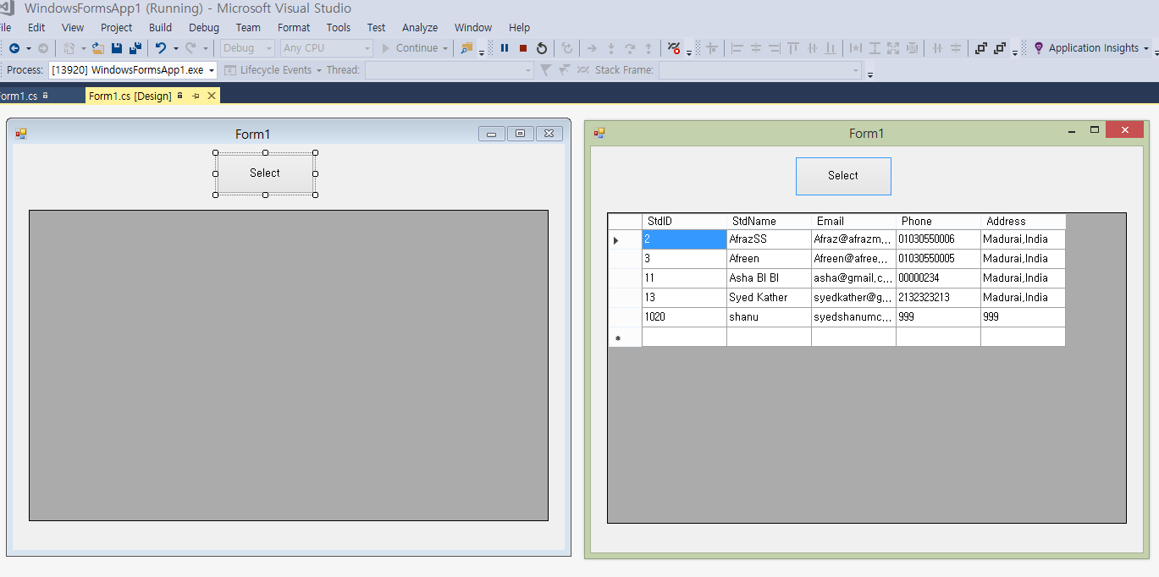
Working with Windows Application

Slide 12
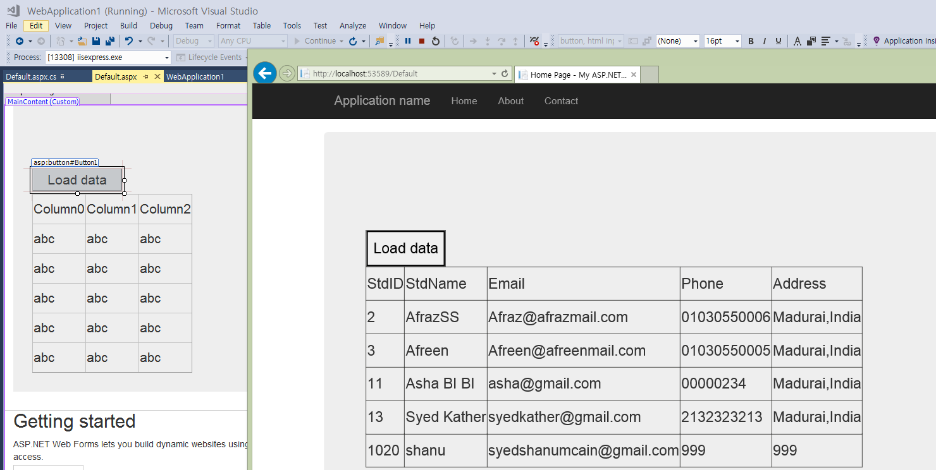
Working with Web Forms Application

Slide 13
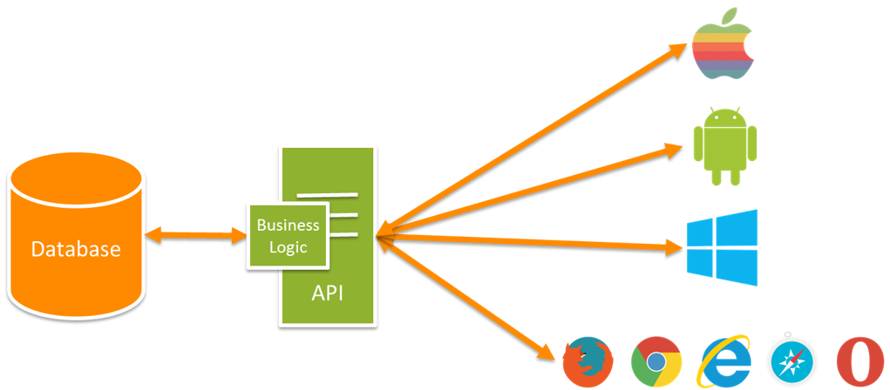
Web API
API stands for ‘Application Programming Interface’
Web API is a simple and easy way to build HTTP Services for Browsers and Mobiles.
Web API has the following four methods as Get/Post/Put and Delete where:
Get is to request for the data. (Select)
Post is to create a data. (Insert)
Put is to update the data.
Delete is to delete data.

Slide 14
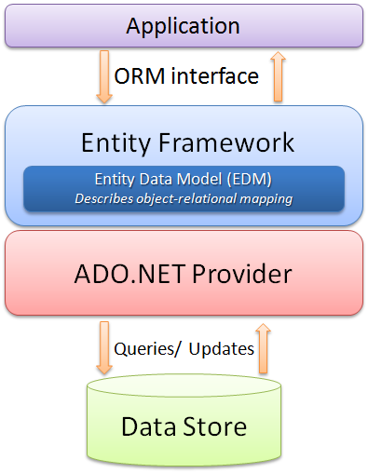
Entity Framework
Entity Framework is an Object Relational Mapper (ORM)
ORM is a tool for storing data from domain objects to relational database like MS SQL Server
Microsoft has provided an O/RM framework called "Entity Framework" to automate database related activities for your application.
It eliminates the need for most of the data-access code that developers usually need to write.
Performing basic CRUD (Create, Read, Update, Delete) operations.
Easily managing "1 to 1", "1 to many", and "many to many" relationships
We can have all data access logic written in higher level languages

Slide 15
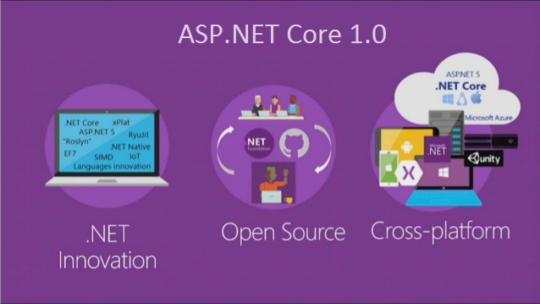
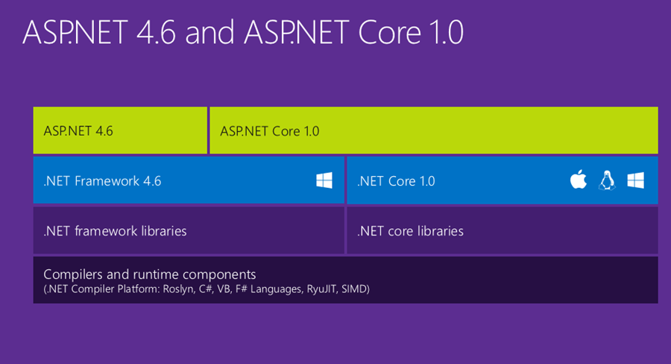
ASP.NET Core
ASP.NET Core :
ASP.NET Core is a new open-source and cross-platform framework for building modern cloud based internet connected applications, such as web apps, IoT apps and mobile backends.
ASP.NET Core is fully open source and available on GitHub. ASP.NET Core is available on Windows, Mac, and Linux.
ASP.NET Core apps can run on .NET Core or on the full .NET Framework.
ASP.NET Core is no longer based on System.Web.dll. It is based on a set of granular and well factored NuGet packages.
ASP.NET Core is designed to integrate seamlessly with a variety of client-side frameworks, including AngularJS, KnockoutJS and Bootstrap

Slide 16
Learn More from here
http://www.c-sharpcorner.com/UploadFile/asmabegam/datagridview-crud-with-image-save-to-sql-server-using-C-Sharp/
http://www.c-sharpcorner.com/UploadFile/asmabegam/insert-select-update-delete-in-Asp-Net-with-simple-login/
http://www.c-sharpcorner.com/UploadFile/asmabegam/mvc-angularjs-masterdetail-crud-filter-and-sorting-using-w/
http://www.c-sharpcorner.com/article/asp-net-core-angular-2-crud-with-animation-using-template-pack-web-api-and-ef/
http://www.c-sharpcorner.com/UploadFile/asmabegam/vs2015-rc-windows-universal-app-for-name-puzzle-game/

Slide 17
Other Microsoft Technologies
Microsoft Azure
SharePoint
Dynamic CRM
Power BI
BOT Framework
Data Platform
Cloud
Office Development
Windows PowerShell
Power BI

Slide 18

How to improve your Career on Microsoft .NET Technology
Pick any one of your favorite Microsoft Technology
Learn more and more deeply till you satisfied
Use google
Use community web sites
Be confident on your self
Engage in developing more self projects
Join with friends and organize events and seminars
Invite speakers or be a speaker
Learn and Teach
Share your ideas in Microsoft Students partner
Contribute in community and improve your networks

Slide 19

Microsoft Academic Programs

Slide 20

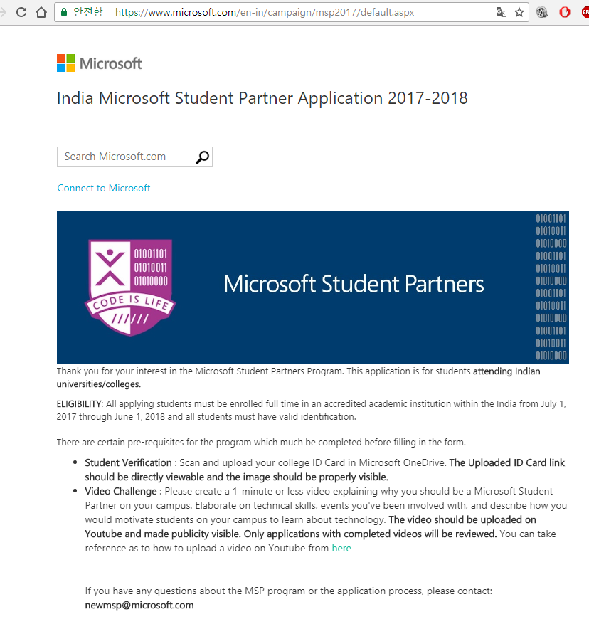
Microsoft Student Partners
Run workshops and hackathons
Host tech events and give demos on campus
Work alongside Microsoft professionals, assisting them during hackathons and events
Join exclusive Microsoft training events to learn the latest technologies
Grow and nurture a community of students and faculty on-campus and online
Enhance their skills and career opportunities
Get amazing jobs
https://www.microsoft.com/en-in/campaign/msp2017/default.aspx

Slide 21



Microsoft in Education Student Initiatives Come Build your Skills, Ignite your Career.
The Microsoft Student Partners is a global program to encourage students who have a demonstrated passion for technology and want to share this with their friends & peers.
India has over 1200 MSPs across engineering campuses.
Microsoft Imagine Cup is the world’s premier student technology competition where participants use technology to solve the world’s toughest problems. Started in 2003, competitors from across 183 countries compete.
Each year, over 50,000 students participate from India.
DreamSpark is a Microsoft program to provide students with software design and development tools, for learning & research, at no charge.
India has the largest number of students downloading DreamSpark software every year.
Official Site Link : http://www.microsoftstudentpartners.com/
Facebook Link : https://www.facebook.com/microsoftindiastudent
Twitter Link : https://twitter.com/msindiastudent
Official Site Link : www.imaginecup.com
Facebook Link : https://www.facebook.com/microsoftimaginecup
Twitter Link : https://twitter.com/imaginecup
Official Site Link : www.dreamspark.com
Facebook Link : https://www.facebook.com/microsoft.dreamspark
Microsoft Virtual Academy (MVA) offers 100s of free online training courses, delivered by experts to help technologists learn & keep pace with innovations.
Lakhs of Indian students elevate their skills on this platform, at their own pace, gaining skills & certification
Official Site Link: www.microsoftvirtualacademy.com Facebook Link: https://www.facebook.com/MSVirtAcademy

Slide 22


Slide 23


Start
Contribution
Why you need to Contribute?

Slide 24





Community to Contribute
https://social.technet.microsoft.com/wiki
http://www.c-sharpcorner.com/
http://www.codeproject.com/

Slide 25

MADURAI
Microsoft User Group (Madurai)

Slide 26
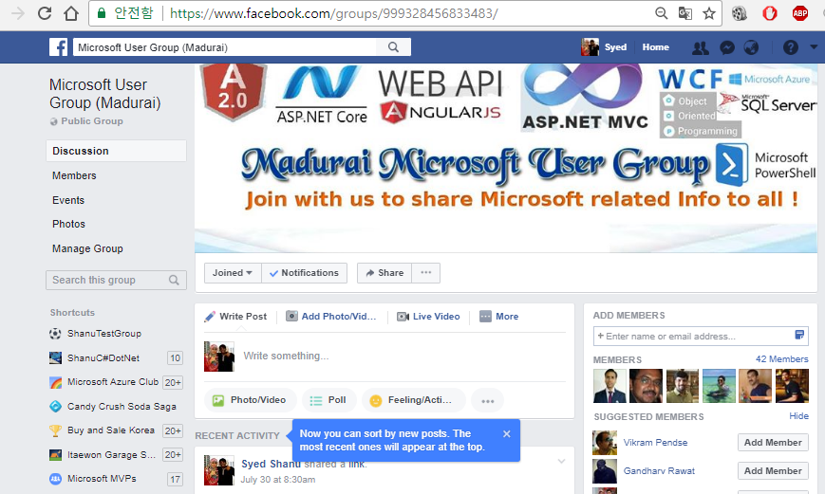
Microsoft user Group Madurai
https://www.facebook.com/groups/999328456833483/

Slide 27

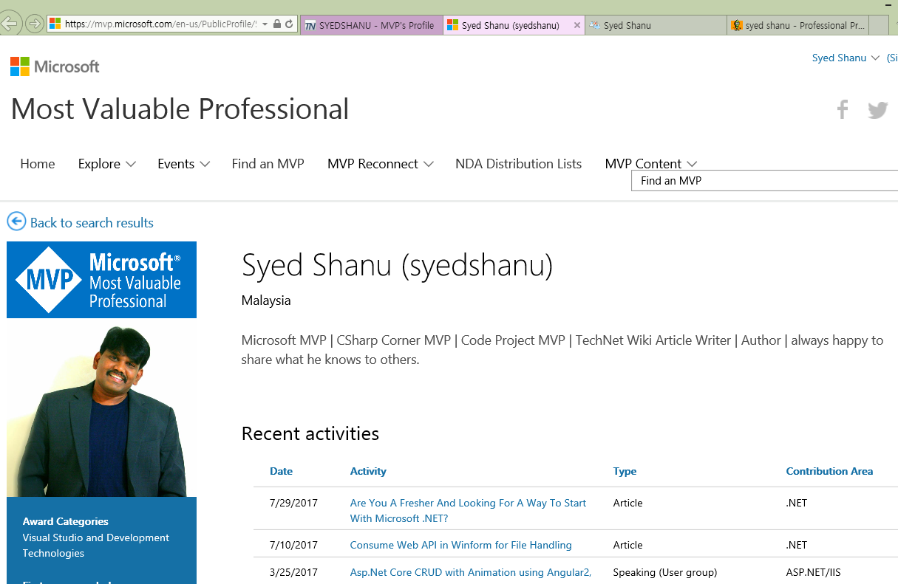
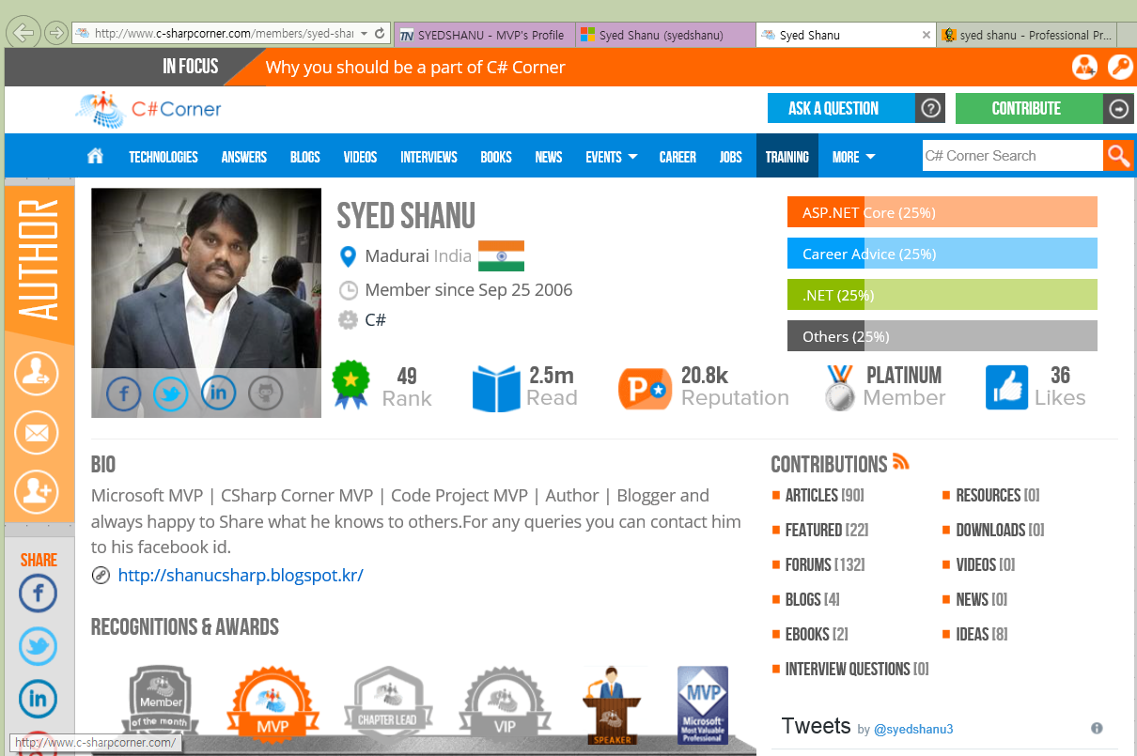
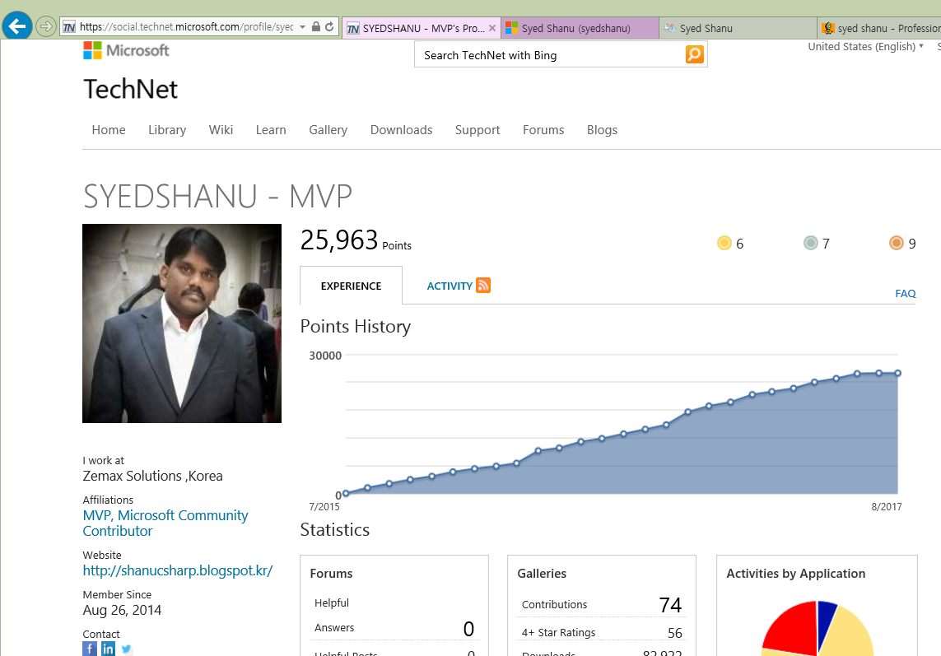
My Profiles
https://mvp.microsoft.com/en-us/PublicProfile/5001980?fullName=Syed%20%20Shanu
http://www.c-sharpcorner.com/members/syed-shanu
http://www.codeproject.com/Articles/syed-shanu
https://social.technet.microsoft.com/profile/syedshanu%20-%20mvp/

Slide 28



Contact Me
syedshanumcain@gmail.com
@syedshanu3
https://www.facebook.com/syed.shanu.9

Slide 29



Questions ?

